Slide 1
Digital Portfolio
STUDENT NAME: DEEKSHA P
REGISTER NO AND NMID:
2428M0007, 7C475CFA8275DC2AC174869E7475DA41
DEPARTMENT: BSc DATA SCIENCE
COLLEGE: KUMARAGURU COLLEGE OF LIBERAL ARTS AND SCIENCE/ BHARATHIYAR UNIVERSITY

Slide 2
PROJECT TITLE
Digital Portfolio using Front-End Web Development (HTML & CSS)

Slide 3


AGENDA
Problem Statement
Project Overview
End Users
Tools and Technologies
Portfolio design and Layout
Features and Functionality
Results and Screenshots
Conclusion
Github Link
3/21/2024 Annual Review

Slide 4

PROBLEM STATEMENT
In today’s digital era, individuals—especially students and professionals—need an effective way to showcase their skills, achievements, and work samples online. Traditional resumes or printed portfolios often fail to capture attention and don’t provide interactive elements to engage viewers. Many people rely on third-party platforms, which limit customization and control over design or content. There is a need for a personalized, lightweight, and responsive digital portfolio that can be built and hosted easily using fundamental web technologies, giving users complete ownership of their content while improving their web development skills.

Slide 5

PROJECT OVERVIEW
This project aims to design and develop a Digital Portfolio using Front-End Web Development (HTML & CSS). It focuses on building a responsive, well-structured, and visually appealing website to display personal information, skills, and projects.
Key Highlights:
Build a lightweight, responsive website using HTML & CSS.
Present personal details, skills, projects, and achievements.
Follow clean design, semantic HTML, and accessibility principles.
Optimize for desktop, tablet, and mobile screens.
Gain practical experience in front-end development while creating a professional online presence.

Slide 6

WHO ARE THE END USERS?
Myself
Recruiters and Hiring Managers
Mentors and Professors
Peers and Collaborators

Slide 7

TOOLS AND TECHNIQUES
HTML
CSS
JS(JavaScript)
VS Code
Chrome

Slide 8
POTFOLIO DESIGN AND LAYOUT
The digital portfolio is designed with a calm and minimalistic theme using light pink and light blue to have a pleasant and professional look.
The layout is user-friendly and simple, that begins with a header that contains a small navigation bar having About, Projects and Contact space.
The about section gives a brief description about me with a profile picture and my personal and professional interests that gives a basic knowledge about myself to the viewers/users.
The projects section clearly speaks about the projects and works accomplished by me. That involves my internships, paper presentations and developing project ideas.
The contact section acts as a space that allows for enquiries. Finally, the footer maintains the consistent theme, provides a complete and neat closure to the portfolio.
8

Slide 9
FEATURES AND FUNCTIONALITY
The Interactive Digital Portfolio is designed with a responsive layout that adapts seamlessly to desktops, tablets, and mobile devices, ensuring accessibility across platforms. It includes an About Me section that introduces personal background and career aspirations, a Skills Showcase to highlight technical and soft skills, and a Projects Gallery to display academic and personal works with relevant descriptions and links. Additionally, it features an Achievements section for certifications, awards, and milestones, along with a Contact Section to provide easy communication channels. Built entirely with HTML for structure and CSS for design, the portfolio emphasizes a clean user interface, smooth navigation, and a professional yet visually engaging presentation.

Slide 10
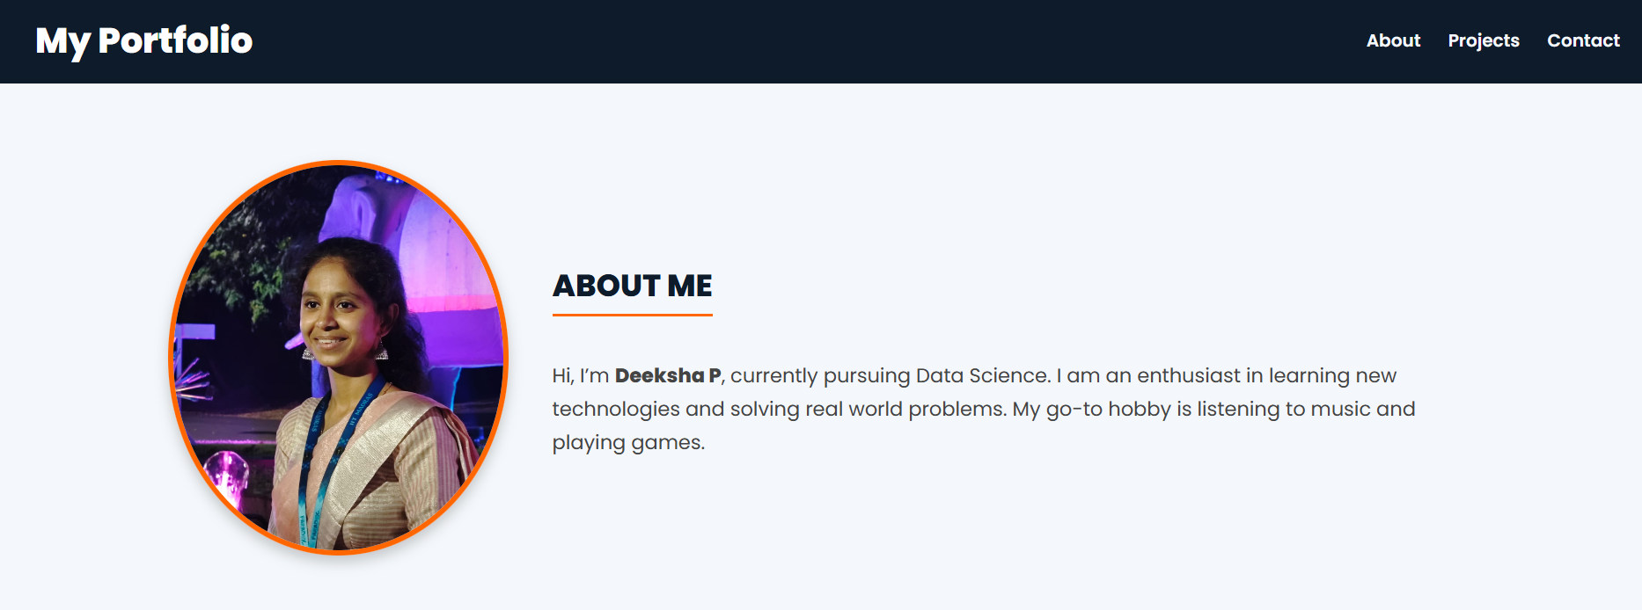
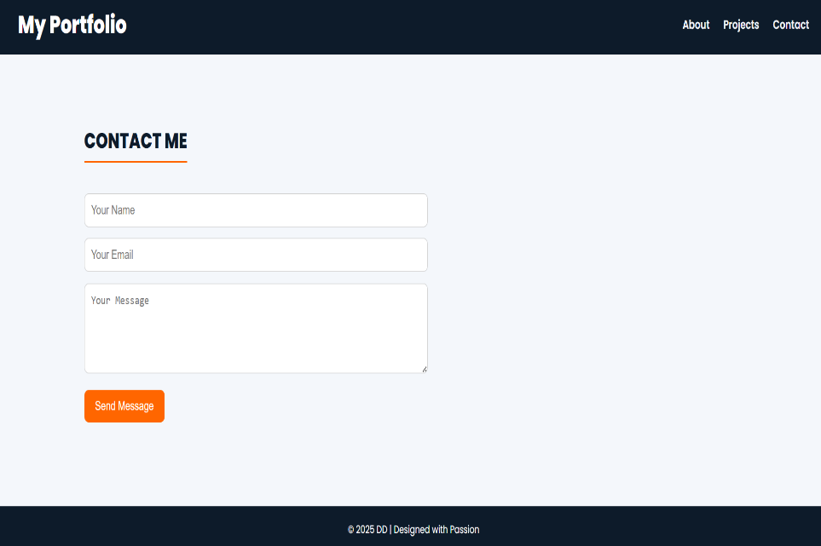

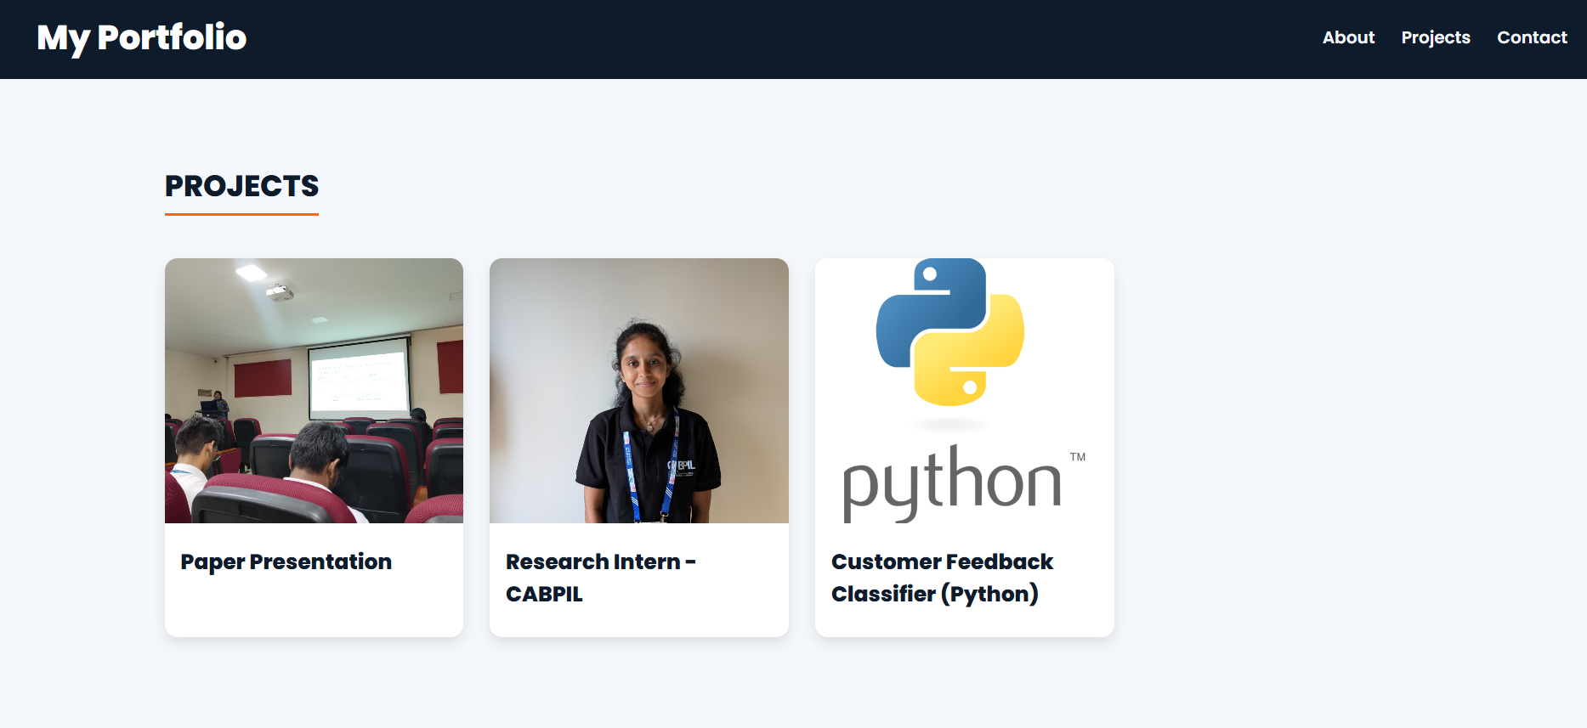
RESULTS AND SCREENSHOTS
3/21/2024 Annual Review
10

Slide 11
CONCLUSION
The Interactive Digital Portfolio successfully demonstrates how front-end web development using HTML and CSS can be applied to create a professional, responsive, and user-friendly platform for showcasing personal and academic achievements. By going beyond a traditional resume, the portfolio provides an engaging medium to highlight skills, projects, and experiences in a visually appealing format. This project not only strengthens web development skills but also establishes a digital identity that can support academic growth, career opportunities, and professional networking.
11

